Slide 1
Ellipsoid-Based Path Planning
Group Meeting
05/25/2018

Slide 2
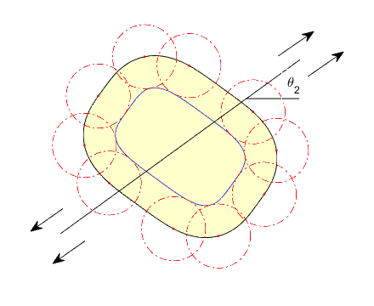
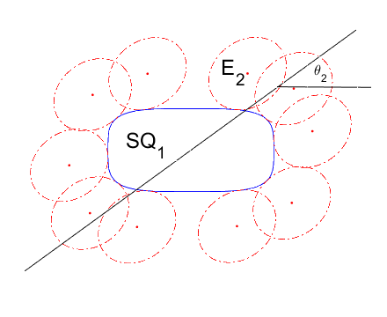
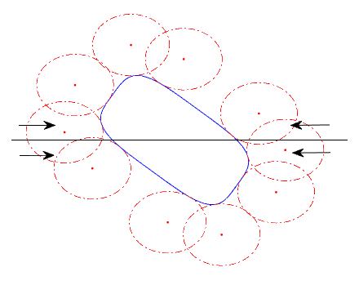
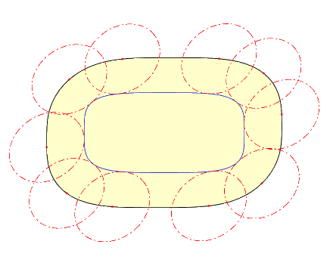
Highway Roadmap planner
C-Space Obstacles: Closed-form Minkowski Sum/Difference
Affine Transformation (Shrinking) -> Shrunk Space
Offset Curve
Inverse Transform (Stretching)
Closed-form Minkowski Sum

Slide 3
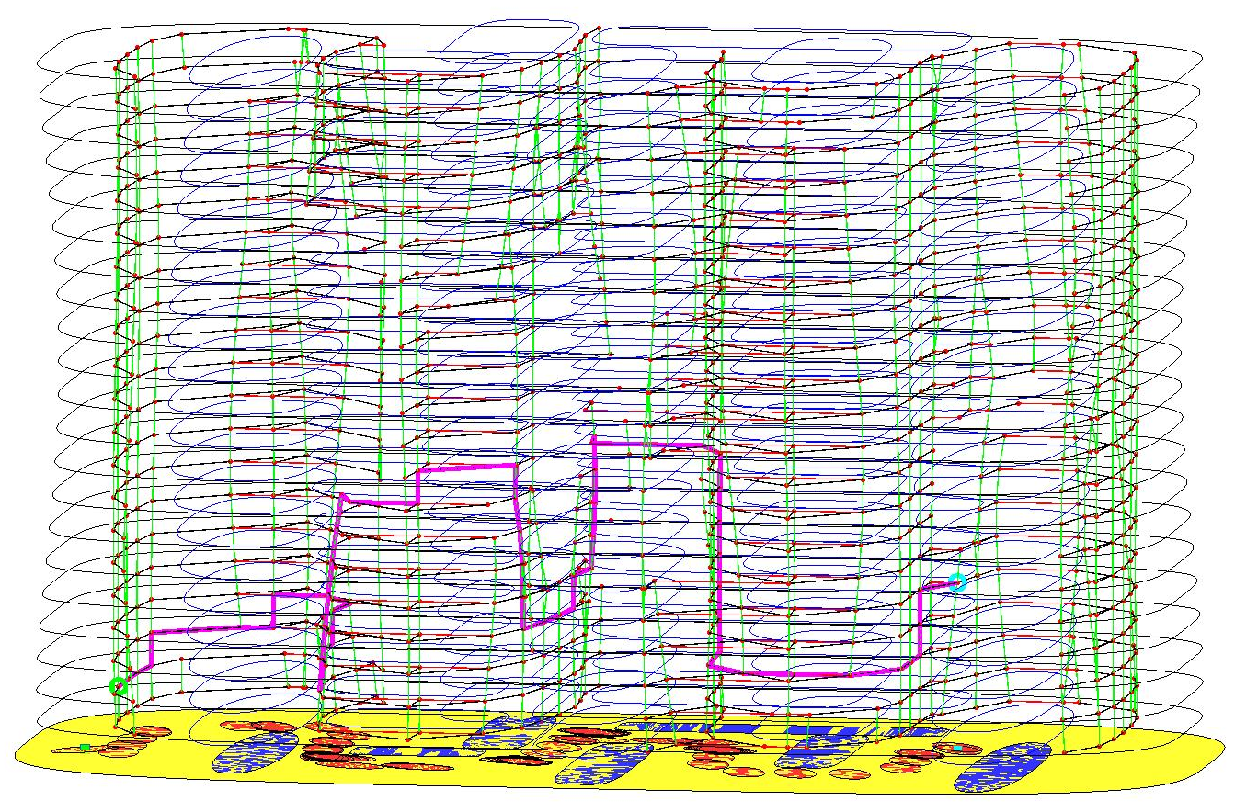
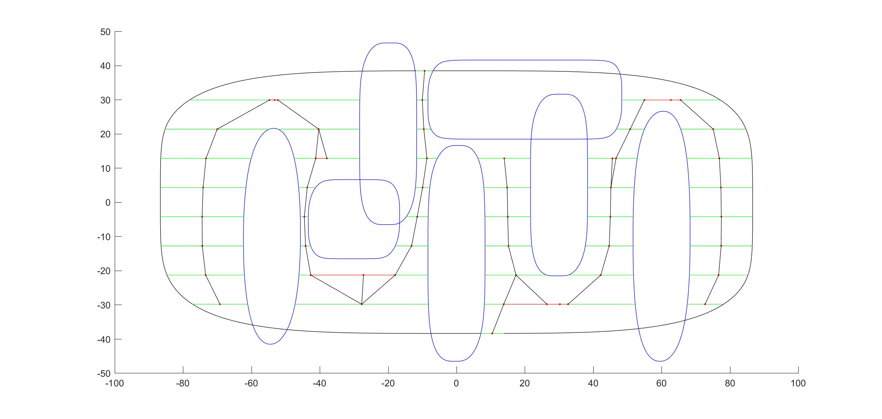
Highway Roadmap planner
Free-Space Characterizations
Discretize Rotation
Cell Decomposition: At each C-Layer
Edge Connections between Collision-free Vertices Within one layer
Connect between adjacent cells
Between different layers
Enlarge the robot, compute local c-space
Intersection of two local c-space
Highway Roadmap Planner for 2D Rigid Body
Collision-free Cells and Roadmap in One Layer

Slide 4
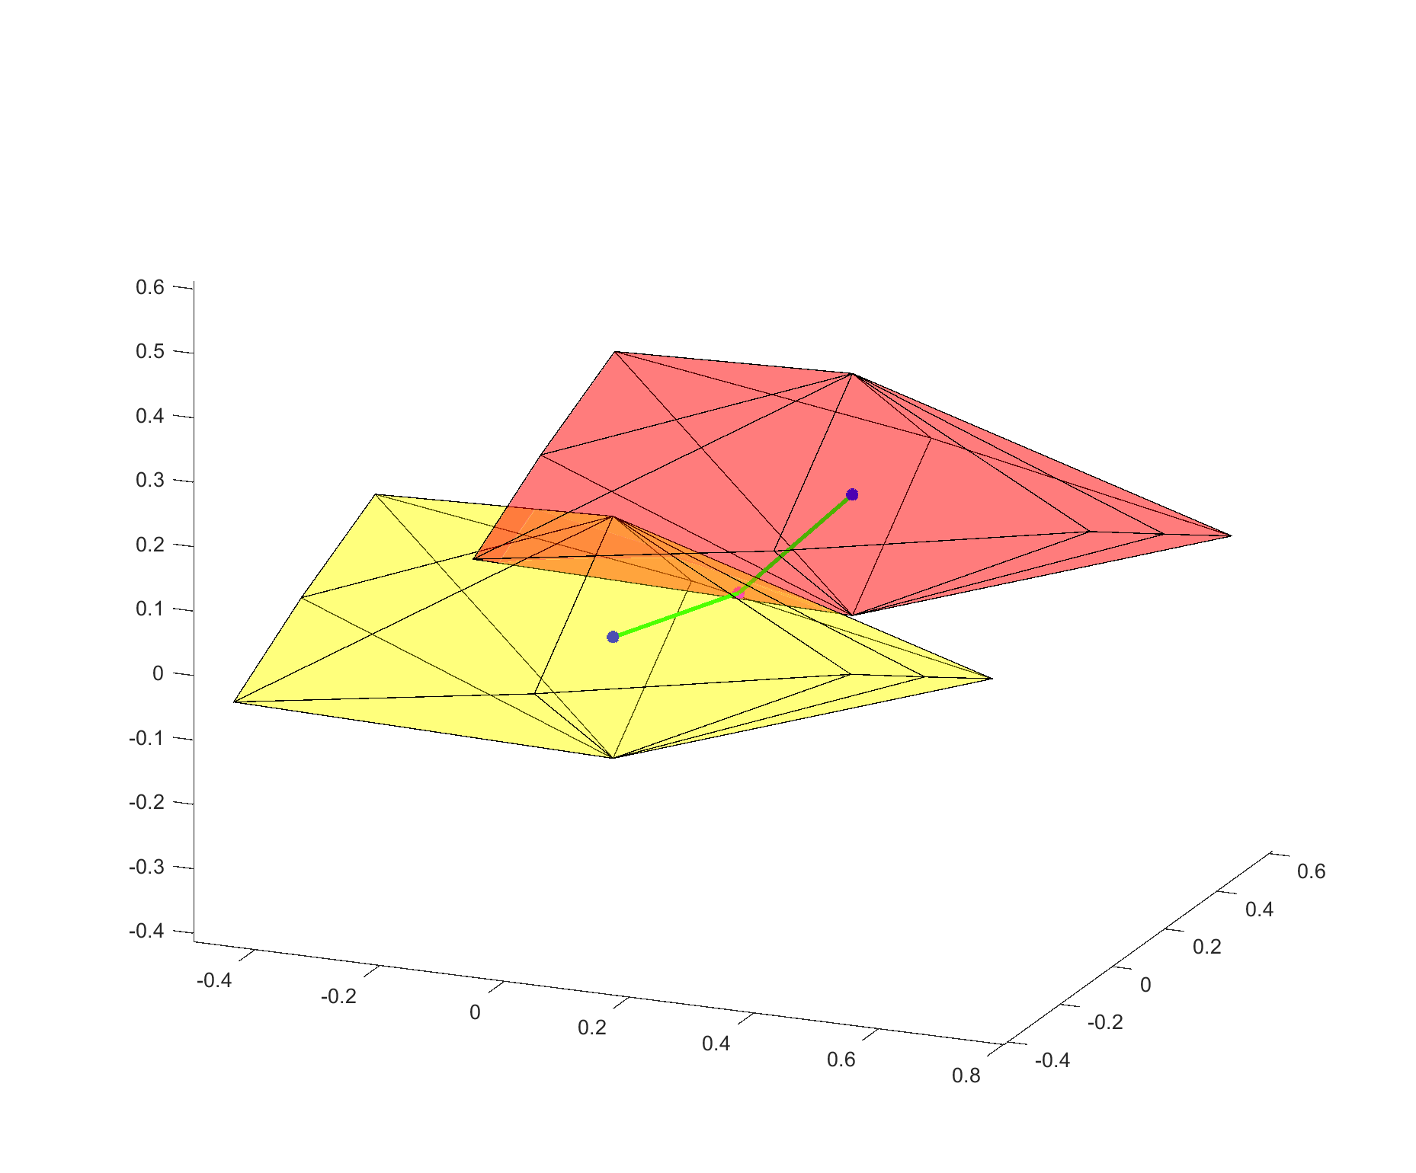
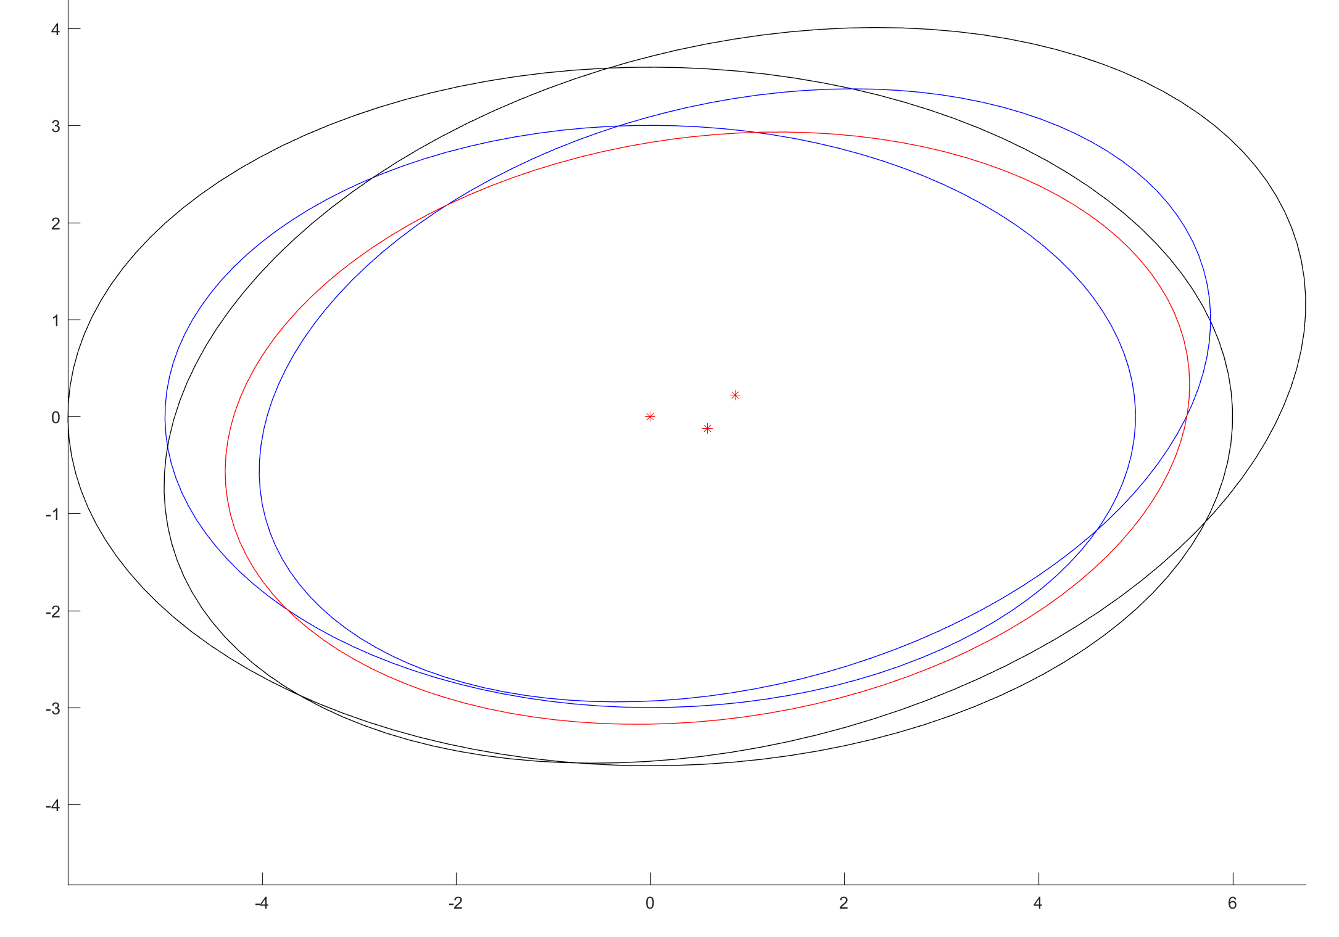
Strategy to connect vertex between different C-layers
Enclose the robot by a slightly larger ellipsoid
Compute Minkowski Sum/Difference using the larger ellipsoid
Robot can move inside free of collision
Description of such motion formulates a “local c-space” for the vertex
Lower bounds for allowable motion of an ellipsoid contained in another
New vertex at the intersection between the local c-space of two vertices
Connect new vertex with the two original vertices respectively
Illustration of the problem
Local C-space for Vertex Connections between Different Layers
Result
Layer i
Layer i+1
Robot

Slide 5
Current Work Summary
Converting implementations from Matlab to C++
Inputs: shape parameters for superquadrics obstacles, ellipsoid robot
Minkowski Sum/Difference between ellipsoids and superquadrics
Cell decomposition by sweep-line procedure
boundary enlarging (-> polygon bounding boxes for c-obstacles)
decompose to polygon cell
Vertex connections within one layer
Vertex connections between adjacent layers
Minimum distance neighbors
KC connection strategy
Graph search (Dijkstra or A*)
Connect to MoveIt and benchmark algorithms

Slide 6
Other work in the near future
Obtain environment shape parameters from point clouds
Enclose points by superquadrics
Compare with Oriented Bounding Box
Metric: Efficiency and volume percentage of occupancy
Hybrid with PRM
Sample the orientation
Test on a real holonomic mobile robot system

